Slide 1

Ikporo Onitsha USA
Medical Mission
December 29th 2019

Slide 2

Women for Women Organization Founded in 2003

Slide 3
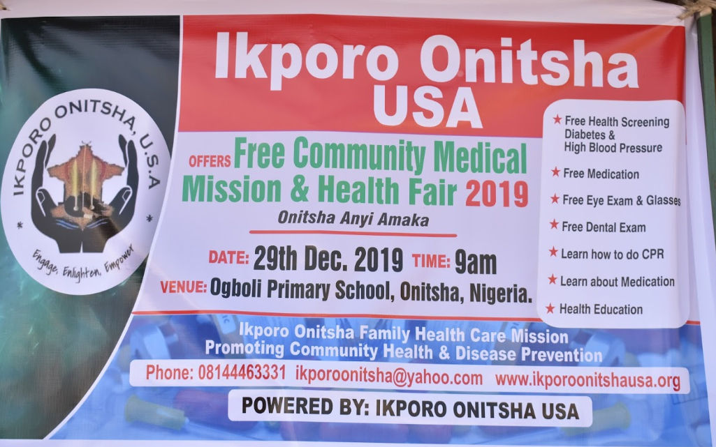
Medical Mission 2019

Slide 4
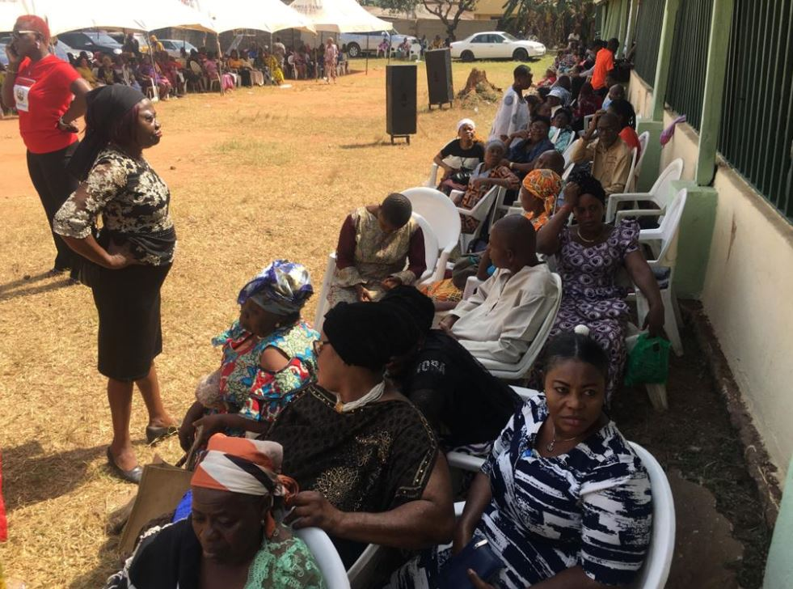
Scenes from the Medical Mission

Slide 5
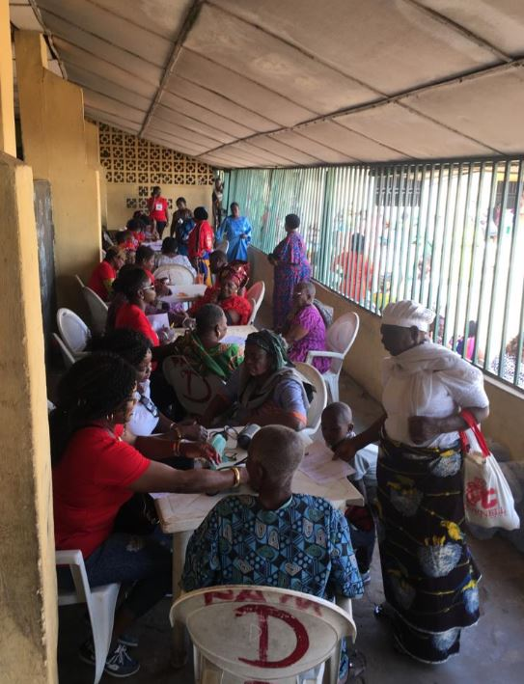
Scenes from the medical mission
Triage & Blood Pressure Screening

Slide 6
Medical Mission 2019
Committee
Dr. Meg Egbunike (Chair)
Dibueze Uche Onwuli*
Rita Bato Okaka*
Tina Melifonwu *
Bato Osili*
Nkoli Uwechia*
Dr. Joy Egbunike*
Dr. Otito James*
Nwaeze Dr. Ifeanyi Chukwuma*
Oby Egbunike
Ugodibeze Dr. Azuka Obianwu*
Ifeoma Nwosisi
Dr. Ngozi Egbunike
Enyi Ugodibeze Chinelo Nzegwu*
Chinwe Nwora
Enyi Omeorafu Ify Odili
Enyi Omu Dr. Evelyn Nwaigwe
Dr. Stella Ebo
Ifeoma Azubogu
Also Assisting (our children) Uzoamaka Uwechia; Emengini Chukwuma, Kaosi Egbunike Aghadiuno, Whitney Ubaike
*represented live

Slide 7
Ikporo Onitsha USA Medical Mission
> 600 people received care
$11, 976.70
All participants received prescription medications, analgesics, vitamins, antiinfectives as prescribed by local physician
10
Ikporo Onitsha members onsite
Diabetes
High BP
Dental
Eye
Education
Local Health Care providers worked alongside our Ikporo Onitsha USA members
Mission lived on through donation to OAMM
> 100, 000 tablets & capsules valued at $20k
Donation of all items used e.g BP machines, glucometers, test trips and extra medications

Slide 8
Ikporo Onitsha Medical Mission
Unprecedented
Comprehensive
Medical Care
Provided by Practicing Physicians
(Diabetes/BP Screening & Treatment)
Dental Care
Provided by Dental Practitioners
Screening, Education, tooth brushes/paste etc. provided
Eye Care
Provided by Practicing ophthalmologist and optometrists
200 eye glasses provided
Screening & Education Provided by Registered Nurses, Nurse Practitioners, Pharmacist & Chemists

Slide 9
Ikporo Onitsha USA
Medical Mission
  Medication and Supplies (valued at over $20,000)
  > 100,000 tablets & capsules
  6 Glucometer machines
  2, 220 Glucometer strips
  2 BP Machines
  1400 Lancets
  500 Keto diastix
  200 Prescription reading glasses
  Assorted dental supplies
  Assorted Medications and supplies

Slide 10
Medical Mission
2019
Donation to Onitsha America Medical Mission
Our Medical Mission continues to reverberate through our donations of Medication and Supplies to Onitsha America Medical Mission in Onitsha
  70,000 tablets & capsules
    Antidiabetic, high blood pressure medication, vitamins. Etc.
  6 Glucometer machines
  1,900 Glucometer strips
  2 BP Machines
  1,200+ Lancets
  500 Keto diastix
  Assorted Medications and supplies

Slide 11

Mission Driven Initiatives
2021
Based on our 2020 Strategic Planning meeting
Focus on the Girl Child - Education Focused (mentorship programs, holistic approach –starting with parents, economic development to combat hunger, greed and drug abuse; value orientation and programs that highlight our culture and values)
Focus on Recent Graduates – advocate for training opportunities, reorientation to master trade skills sets, - Olu aka, (what can you do); support Entrepreneurship; technical centers/trade school, access to microfinancing;
Ikporo Ogbe Engagement/focus group meetings – “ife eji abu Onicha Erika ” & Health Insurance, national identification, political involvement, empowerment & sustainability
Focus on the vuneralbspecial needs and harnessing special gifts; mentorship not always intellectuals;
Access to microfinancing and business loan (business incubation center utilization)
Liaise and support existing Ime Obi structures aligned with our mission and strategic plan
In the USA - Language and cultural education initiative is a primary focus, committee to reconvene to determine strategies to be launched this year

Slide 12
2021:
Mission-Driven
Goal-Oriented
Mission Statement
  Ikporo Onitsha USA is committed to engaging, enlightening and empowering Onitsha women to participate in the promotion of the cultural, social, educational, and economic development of Onitsha people in the United States and at home.
Goals
  To provide a forum for Onitsha women in the United States of America to develop a network of support by emphasizing the importance of a united, peaceful, progressive and participatory women’s group.
  To provide a networking forum to support the social, cultural and educational growth of our children and our community.
  To encourage and support the development of practical solutions to health care problems in Onitsha.
  To encourage community service among our children by encouraging volunteerism of Onitsha youths in service of Onitsha both in USA and at home.
  To advocate for a multi-purpose skills and recreation center in Onitsha that will serve to support the growth and development of women and our youth.
  To facilitate and advocate for the provision of micro credit to women and youth in order to encourage entrepreneurship.

Slide 13
Ikporo Onitsha USA
Powered by:
Our members

