Slide 1
Ikporo Onitsha USA Virtual Convention – May 29th & 30th
Theme: An Experience for your Spirit, Mind & Body
Chairperson: Nwaezebuona Nkoli Stella Uwechia
Committee: Ikporo Onitsha USA Advising Committee members

Slide 2

Our 2-day Event

Slide 3
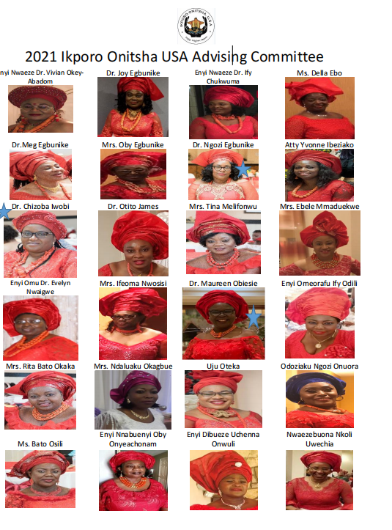
Planning
May 2, 2021
May 16, 2021

Slide 4
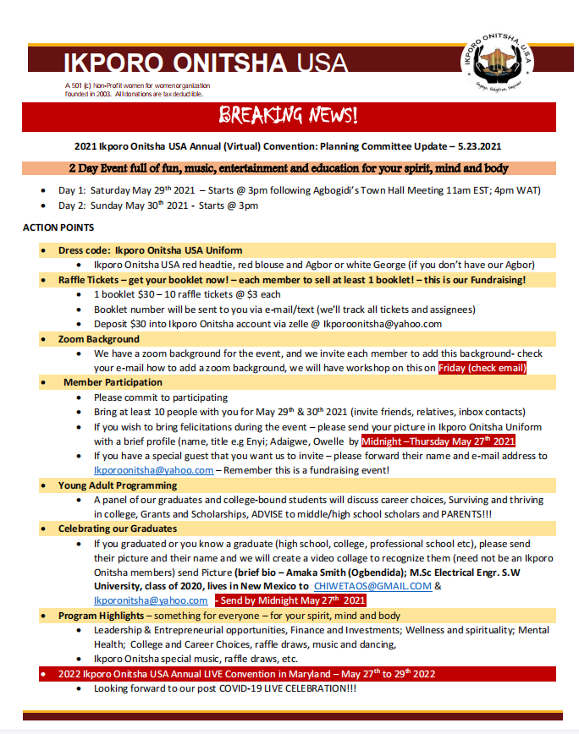
Planning:
General Meeting to update the membership
5.23.2021

Slide 5
Final Program
IKPORO ONITSHA USA VIRTUAL CONVENTION MAY 29-30 2021 PROGRAMME.pdf
2 Day Event: Click here link for the programme booklet IKPORO ONITSHA USA VIRTUAL CONVENTION MAY 29-30 2021 PROGRAMME.pdf
Identified Speakers
  Goodwill addresses
  Entrepreneurship
  Mindfulness
  Mental Health Stress Management
  Finance Health & Investment
  Women’s health
  Onitsha Advancement Foundation (Ime-Obi Initiatives)
Children and Young Adult Programming
Entertainment
  Special Ikporo Onitsha Song (content/criteria)
  2 Artist identified and engaged
  Aniweta Mazeli (Egwu ndi Eze) - Stellar production
  Ejofor Egboka (Umunna Obiligbo) – production was unusable
Technical Support
  US-based group - $4800 quote
  Nigeria-based group – Mrs. Achukwu-Nwagwu & QVT Media Group : N250K – hired (gave us 50% discount on usual fee)
  QVT Media – developed programming and ran the 2-day event
Raffle Tickets

Slide 6
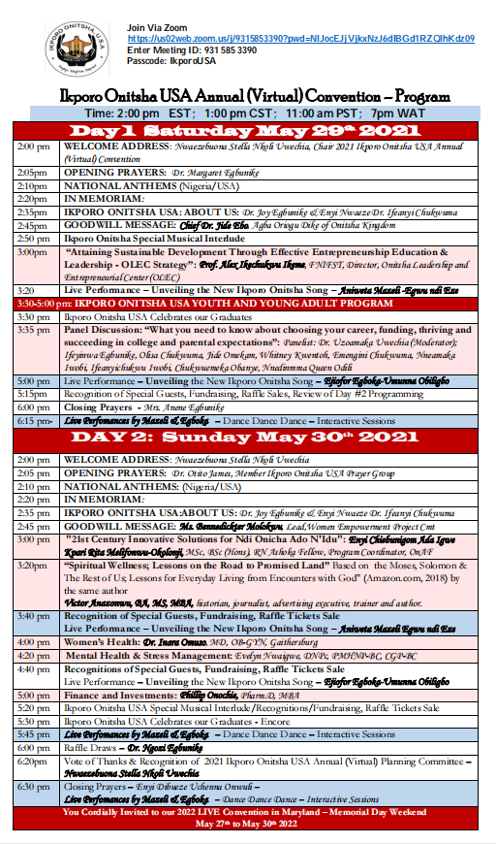
Program of Events

Slide 7
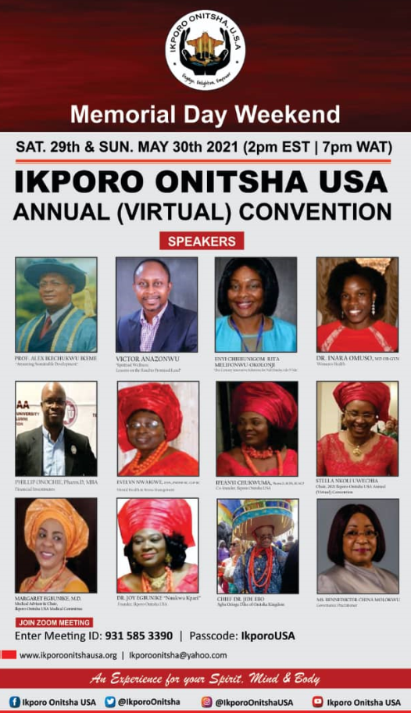

Program Speakers & Panelist

Slide 8
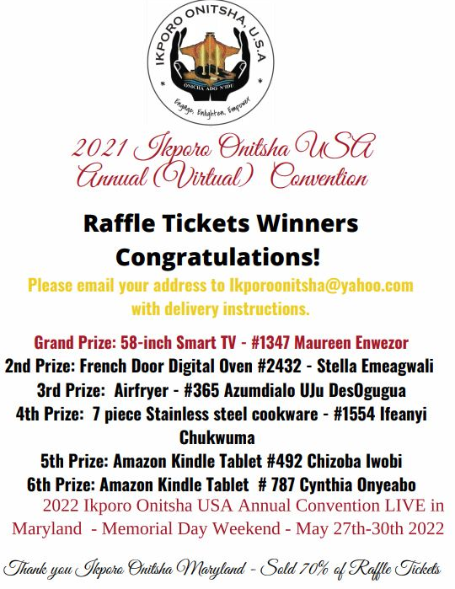

Raffle Ticket Sales
$
Ticket 1554 Sold by I.Chukwuma: Winner Charlene Chatzisterati

Slide 9
Thank you for a
Highly Successful Convention!
Summary
173 different devices logged into zoom for the 2 day convention! (Nigeria, Europe, Canada, UK - world-wide.
Total Funds Raised: $6, 900 (audit pending)
  Raffle Tickets: $6, 200
  Donations: $700 ($500 directly to Long Vacation)
  Raffle Price Purchases: $478.53
  Expenses for the Event N400,000 = $850
  Total net gained = $5,500
  Donation from COVID-19 event: $250
Fundraising – Part of the funds raised will go to Onitsha Long Vacation Program
  Expected donation: N 1 million

Slide 10

We need all hands on deck for our
Live
2022 Event
Sign up to serve on 1 or more Planning Committee

